Slide 1

Appendix: External Data Sources for DEE Common Nodes Queries + Associated Example Queries
Notes:
Our goal is to work with the neuroscience community to perfect this model for the benefit of all of us…
Join us as we apply our breakthrough platform to accelerate the discovery of transformative therapeutics for the hundreds of millions of individuals affected by CNS diseases.

Slide 2
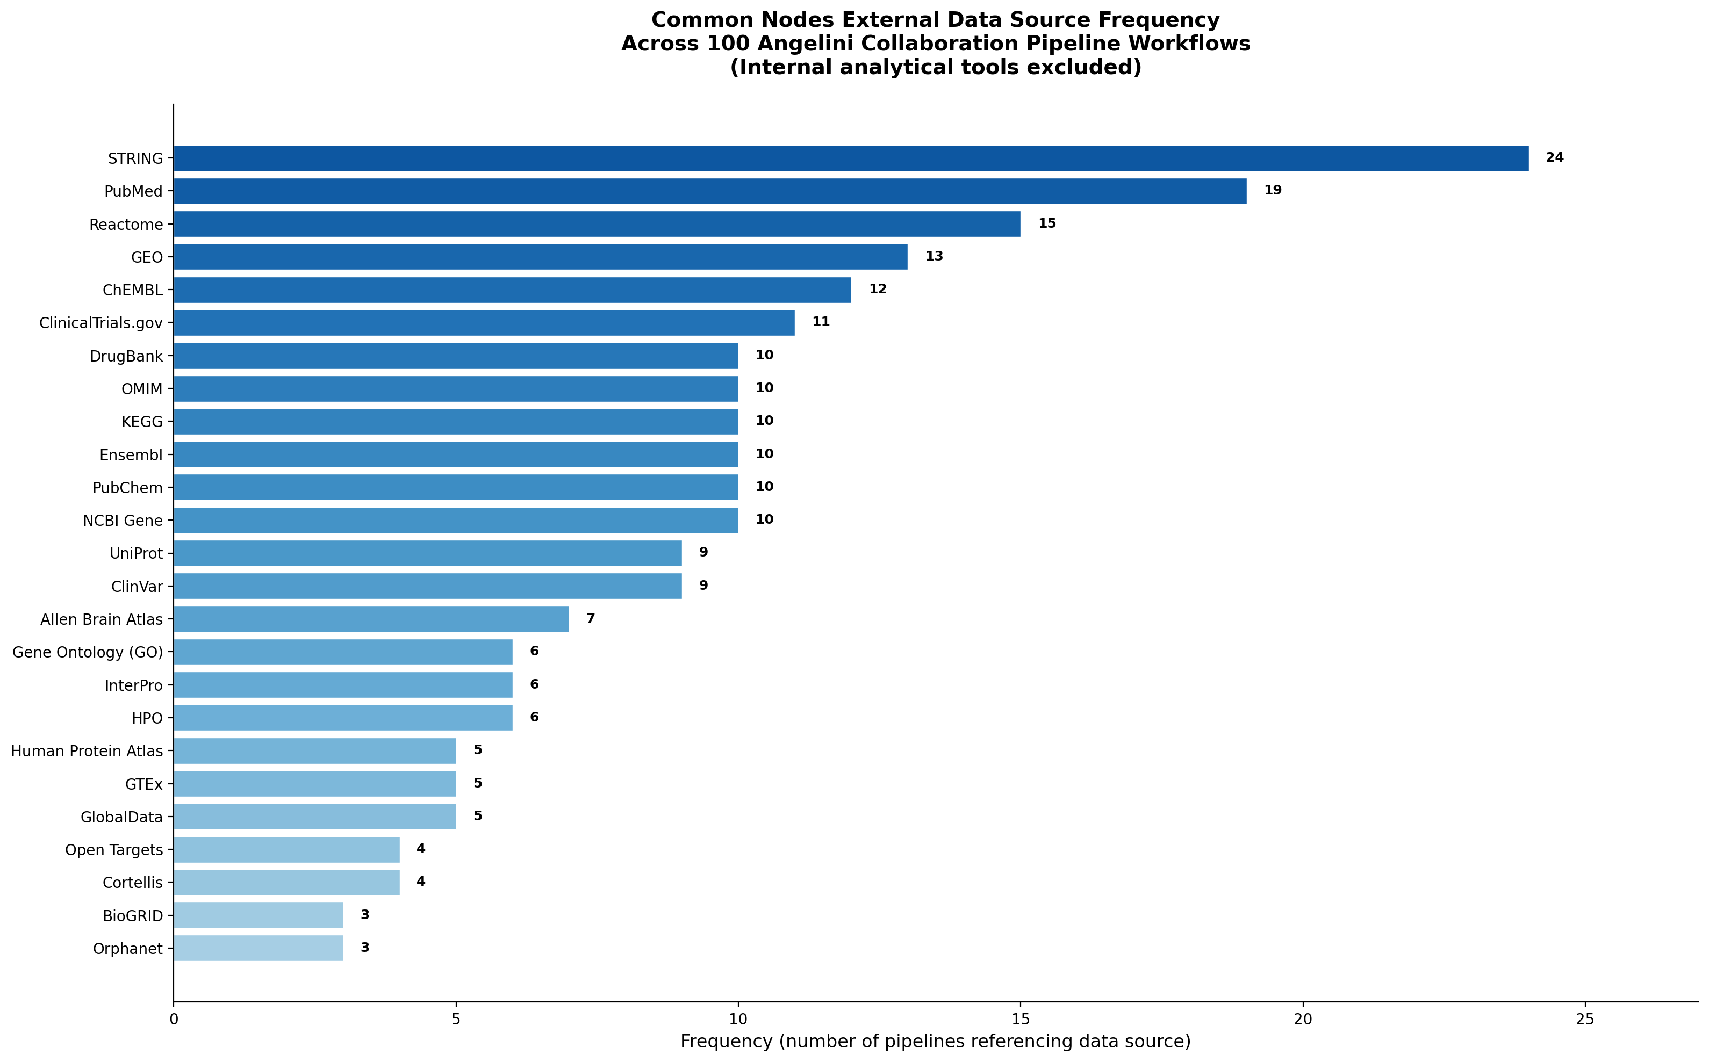
Priority External Data Sources for Common Nodes Workflows Based on Frequency of Use
DEE Common Nodes External Data

Slide 3
Priority External Data Sources for Common Nodes Workflows – Interaction Networks & Literature (Ranked 1–3)
Sapphire GraphDB
STRING Referenced in 24 of 100 pipelines
Protein-protein interaction database providing confidence-scored interaction networks for DEE gene products. Critical for determining whether genes within functional clusters physically interact or share signaling complexes.
Example: Sapphire queries STRING to retrieve all known PPIs among DEE genes within each common node (Prompt #20), determining whether functionally clustered genes are also physically interacting.
PubMed Referenced in 19 of 100 pipelines
Biomedical literature database for retrieving published electrophysiology data, genotype-phenotype correlations, clinical natural history studies, and mouse model phenotyping data for DEE genes.
Example: Sapphire queries PubMed to retrieve published patch-clamp data for CDKL5 and MECP2 variants (Prompt #6), validating Optopatch fingerprints against independent experimental systems.
Reactome Referenced in 15 of 100 pipelines
Curated biological pathway database for enrichment analysis of functional cluster gene sets. Identifies convergent pathway dysregulation across DEE knockouts and nominates druggable pathway targets.
Example: Sapphire queries Reactome to map each cluster’s genes to biological pathways (Prompt #19), testing whether functional clusters correspond to known molecular pathway groupings.
1

Slide 4
Priority External Data Sources for Common Nodes Workflows – Expression Data & Drug Discovery (Ranked 4–6)
Sapphire GraphDB
GEO Referenced in 13 of 100 pipelines
Gene Expression Omnibus repository providing published RNA-seq and microarray datasets from patient iPSC-neuron studies, brain tissue, and disease models for cross-validation of Angelini transcriptomic findings.
Example: Sapphire queries GEO/SRA to retrieve patient-derived iPSC neuron RNA-seq datasets (Prompt #39), assessing concordance between CRISPRn knockout and patient disease models.
ChEMBL Referenced in 12 of 100 pipelines
Bioactivity database linking compounds to biological targets with potency data. Essential for target deconvolution, identifying existing pharmacological tools, and assessing druggability of common node targets.
Example: Sapphire queries ChEMBL to compile existing drugs targeting genes within each cluster (Prompt #46), categorized by mechanism of action and clinical development stage.
ClinicalTrials.gov Referenced in 11 of 100 pipelines
Registry of clinical studies used to identify ongoing or completed trials targeting genes within each functional cluster, informing competitive landscape and repurposing opportunities.
Example: Sapphire queries ClinicalTrials.gov to assess whether therapeutic strategies are disproportionately concentrated in certain clusters (Prompt #25).
2

Slide 5
Priority External Data Sources for Common Nodes Workflows – Clinical Registries & Pharmacology (Ranked 7–9)
Sapphire GraphDB
DrugBank Referenced in 10 of 100 pipelines
Comprehensive drug-target database linking FDA-approved drugs and investigational agents to molecular targets, enabling systematic drug repurposing analysis for DEE functional clusters.
Example: Sapphire queries DrugBank to match FDA-approved drug mechanisms with cluster signatures (Prompt #50), identifying repurposing opportunities via the Therapeutic Target Database.
OMIM Referenced in 10 of 100 pipelines
Online Mendelian Inheritance in Man catalog providing authoritative genotype-phenotype relationships, inheritance patterns, and clinical descriptions for all 131 DEE genes.
Example: Sapphire queries OMIM to cross-reference each DEE gene with its clinical epilepsy syndrome and inheritance pattern (Prompt #1), building the foundational gene-disease mapping.
KEGG Referenced in 10 of 100 pipelines
Pathway and molecular interaction database for mapping DEE genes to biological systems. Complements Reactome for pathway enrichment and identification of shared mechanisms within clusters.
Example: Sapphire queries KEGG to perform pathway enrichment on RNA-seq signatures from 50 DEE knockouts (Prompt #32), identifying convergent pathway dysregulation.
3

Slide 6
Priority External Data Sources for Common Nodes Workflows – Pathway & Genome Annotation (Ranked 10–12)
Sapphire GraphDB
Ensembl Referenced in 10 of 100 pipelines
Genome annotation database providing gene structures, transcript variants, regulatory features, and variant effect predictions for DEE genes and their CRISPRn guide RNA targets.
Example: Sapphire queries Ensembl for gene structure data to evaluate ASO feasibility (Prompt #51), assessing targetable transcript regions for each cluster’s DEE genes.
PubChem Referenced in 10 of 100 pipelines
Chemical compound database linking molecular structures to bioassay results. Used to characterize hit compounds from phenotypic screens and cross-reference chemical scaffolds.
Example: Sapphire queries PubChem to analyze structure-activity relationships among screening hits (Prompt #65), clustering compounds by scaffold and correlating with rescue potency.
NCBI Gene Referenced in 10 of 100 pipelines
Comprehensive gene information resource providing functional annotations, expression profiles, orthologs, and cross-database links for all DEE genes under investigation.
Example: Sapphire queries NCBI Gene to retrieve functional annotations and cross-references for the 131 DEE genes (Prompt #1), establishing the baseline gene information layer.
4

Slide 7
Priority External Data Sources for Common Nodes Workflows – Protein Annotation & Variant Databases (Ranked 13–15)
Sapphire GraphDB
UniProt Referenced in 9 of 100 pipelines
Protein sequence and function database providing domain architecture, post-translational modifications, and subcellular localization data critical for druggability assessment.
Example: Sapphire queries UniProt for protein domain and localization data (Prompt #12), determining whether subcellular compartment predicts Optopatch phenotype direction.
ClinVar Referenced in 9 of 100 pipelines
Archive of genomic variant-disease relationships cataloging pathogenic variants in DEE genes. Enables patient population estimation per cluster and VUS functional prediction.
Example: Sapphire queries ClinVar for all pathogenic/likely pathogenic variants per cluster (Prompt #76), estimating total patient population size per functional cluster.
Allen Brain Atlas Referenced in 7 of 100 pipelines
Spatiotemporal brain gene expression database providing cell-type-specific and developmental expression data for DEE genes, validating neuronal context of Optopatch findings.
Example: Sapphire queries the Allen Brain Atlas to evaluate brain-region and cell-type expression specificity of nominated therapeutic targets (Prompt #40).
5

Slide 8
Priority External Data Sources for Common Nodes Workflows – Functional Ontologies & Phenotype (Ranked 16–18)
Sapphire GraphDB
Gene Ontology (GO) Referenced in 6 of 100 pipelines
Standardized vocabulary and annotation database for gene function, biological process, and cellular component classifications used in enrichment analysis of cluster gene sets.
Example: Sapphire queries GO molecular function annotations to map AP waveform-altering genes to specific ion channel subtypes (Prompt #7).
InterPro Referenced in 6 of 100 pipelines
Protein domain and family classification database integrating signatures from Pfam, PROSITE, and other resources. Used to identify shared structural motifs within functional clusters.
Example: Sapphire queries InterPro/Pfam to determine whether shared domain architecture predicts co-clustering of DEE genes (Prompt #24).
HPO Referenced in 6 of 100 pipelines
Human Phenotype Ontology providing standardized clinical phenotype terms for genetic diseases. Enables systematic comparison of clinical features across DEE genes within clusters.
Example: Sapphire queries HPO to extract standardized seizure types, developmental features, and EEG patterns for cluster-clinical correlation analysis (Prompt #22).
6

Slide 9
Example Queries for DEE Common Nodes Data
Notes:
Our goal is to work with the neuroscience community to perfect this model for the benefit of all of us…
Join us as we apply our breakthrough platform to accelerate the discovery of transformative therapeutics for the hundreds of millions of individuals affected by CNS diseases.

